Slide 1

Customer Analysis for Retail Sales
By Rose Yong

Slide 2

CONTENTS
1. Source of Data Set
2. Business Problems
3. Exploratory Data Analysis
3. Business Questions
4. Recommendations

Slide 3
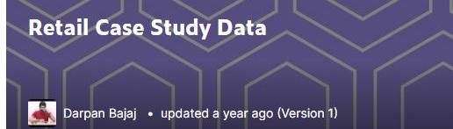
Source of Data Set
Source from Kaggle
3 Files : Customer, Product, Transactions
18 columns , 23054 rows
Data for Year 2011 - 2014

Slide 4

Business Problems
A Retail store is required to analyze the day-to-day transactions and keep a track of its customers spread across various locations along with their purchases/returns across various categories.

Slide 5
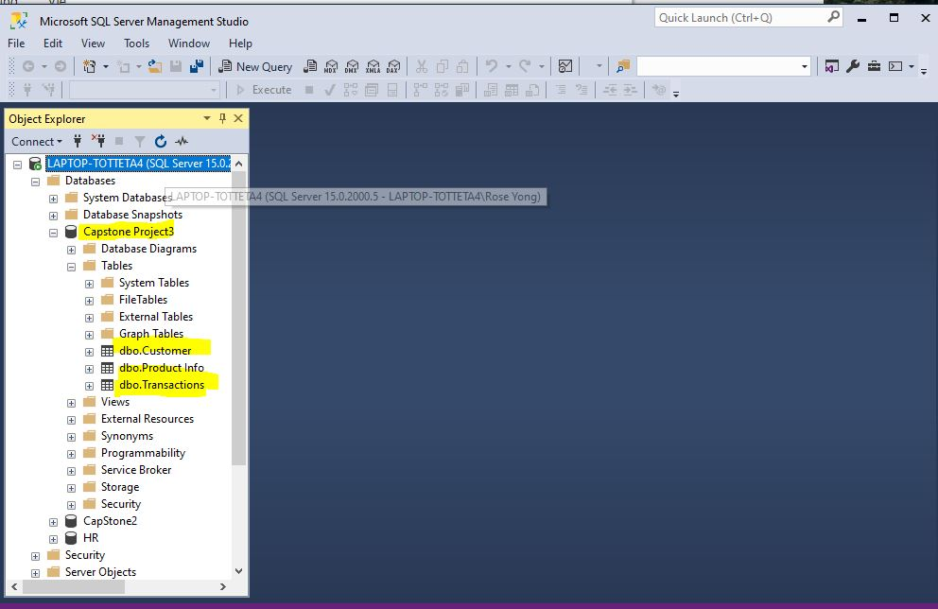
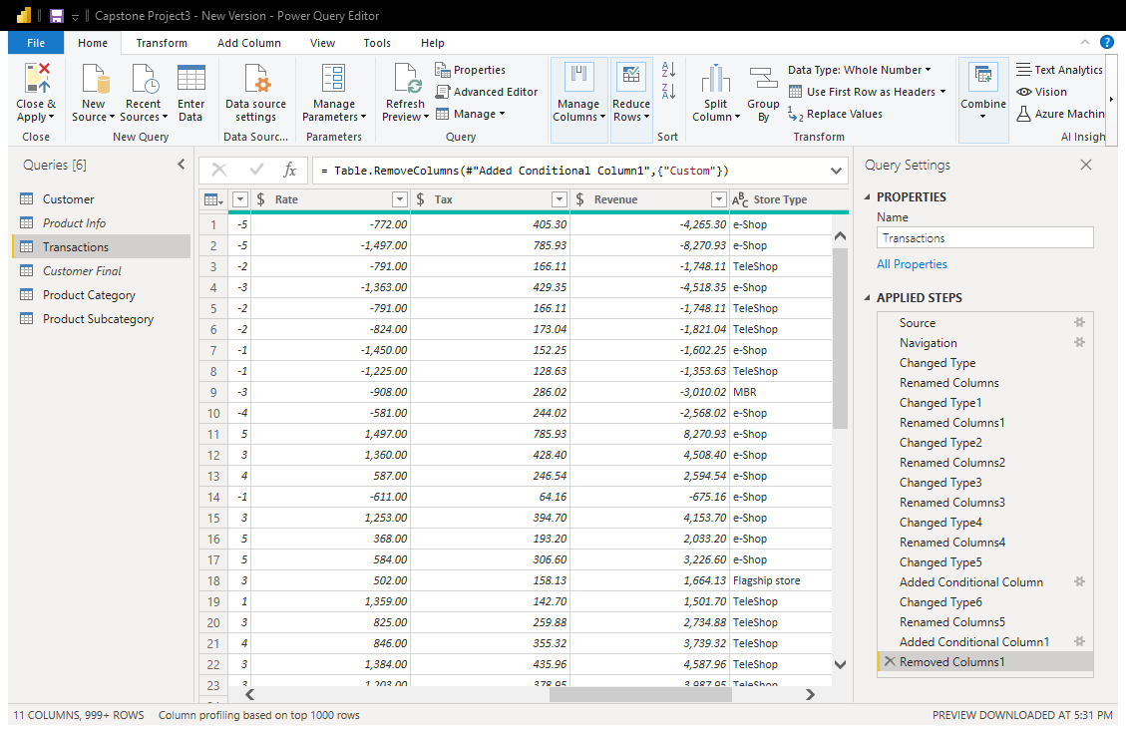
Exploratory Data Analysis
Export data from SQL server to PowerBi
Look out for Null values and duplicate
Change data type for amount column to currency

Slide 6
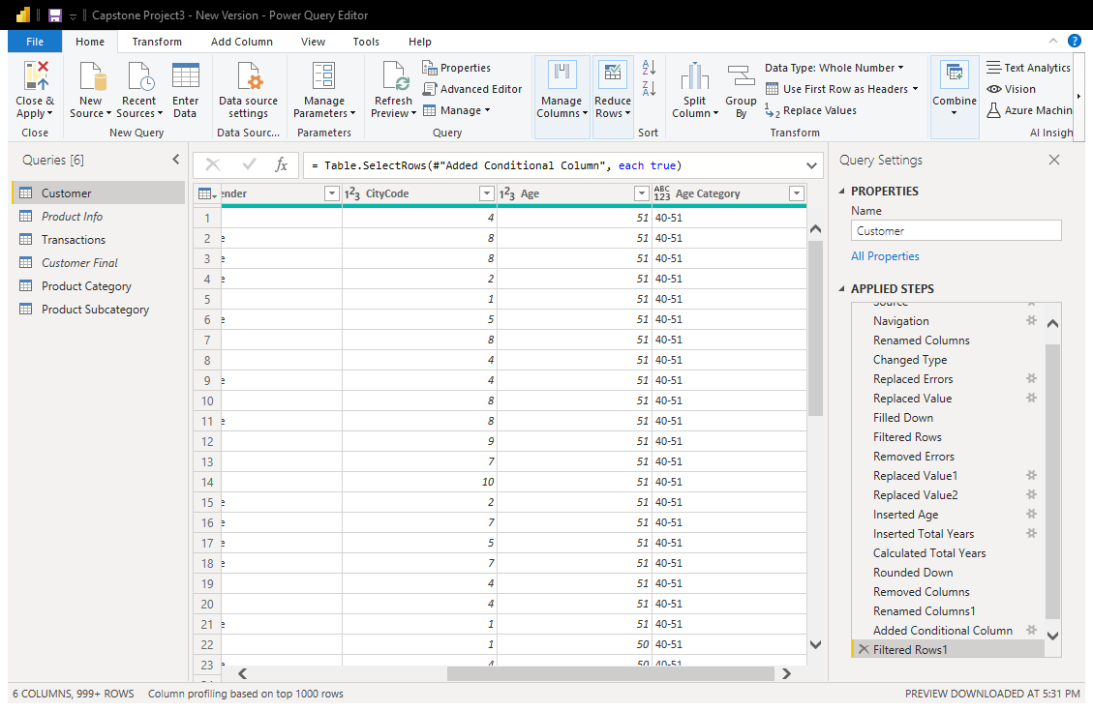
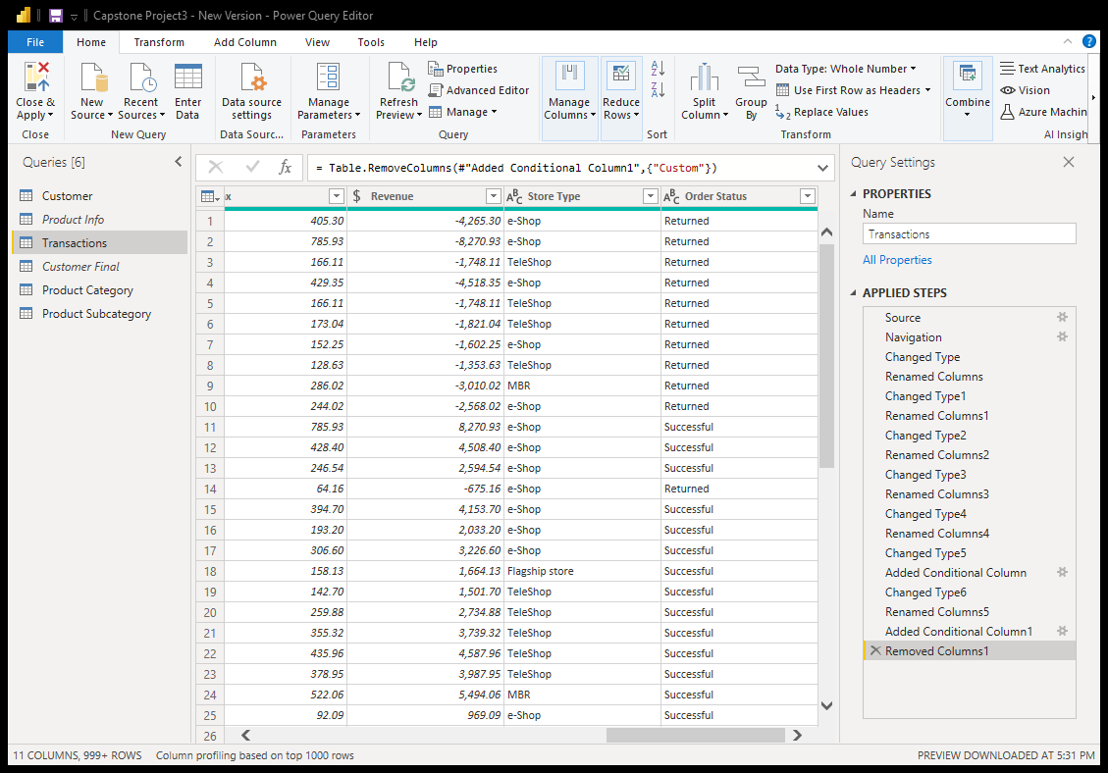
Exploratory Data Analysis
Convert date of birth data to age and group to 3 age categories
Create a new column(Order Status) to analyze which products are returned by customers

Slide 7
Business Questions Recommendations
How to increase sales in City code 6 – Flagship Store?
How to reduce the volume of returned good by customers?
- Improve customer experience –Understand who are your customer.
One way to do this is to segment customer and create personas(or customer profile) giving each persona a name and personality.
- providing 360 degree product images especially for electronics and furniture products

